Slide 1
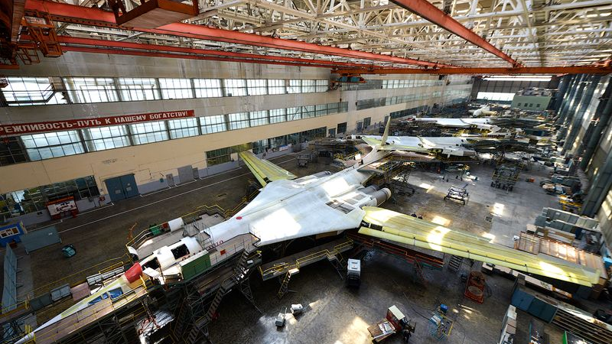
Agile Airplane Game

Slide 2
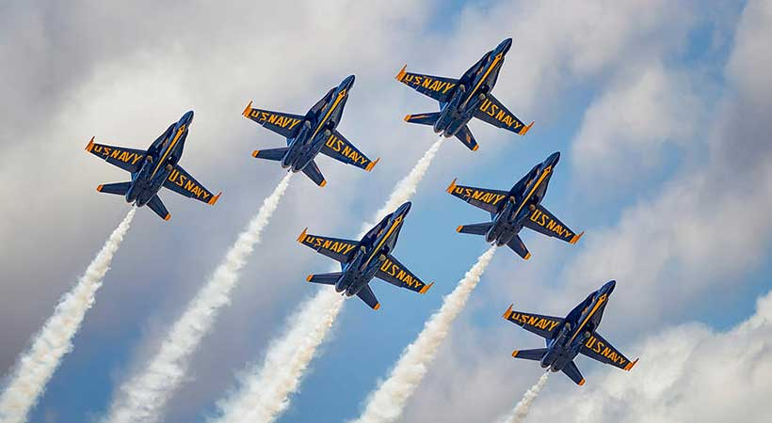

AGILE AVIATION COMPANY
Air shows have become popular spectator events. The demand for planes has increased significantly.
Everyone here is part of the “Agile Aviation Company”.

Slide 3

AGILE AVIATION COMPANY
Air shows across the country have placed orders for planes, we need to fulfill them.
Economics: The company has a burn rate of $12 per team and starts with $40 per team in the bank. Updates are made at the end of each Sprint.
Supplies: spreadsheet and figure templates.
Sprint - 05 minutes
1 min planning
3 min working
2 min retrospective

Slide 4
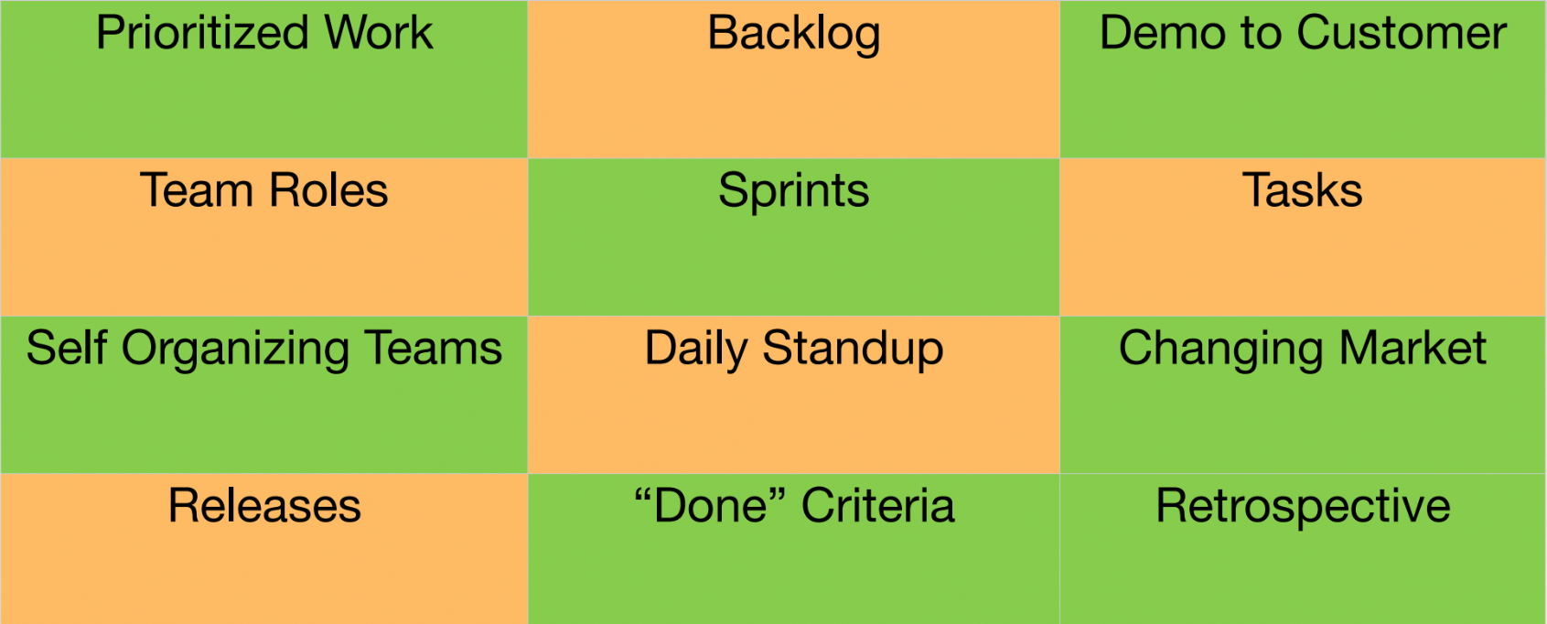
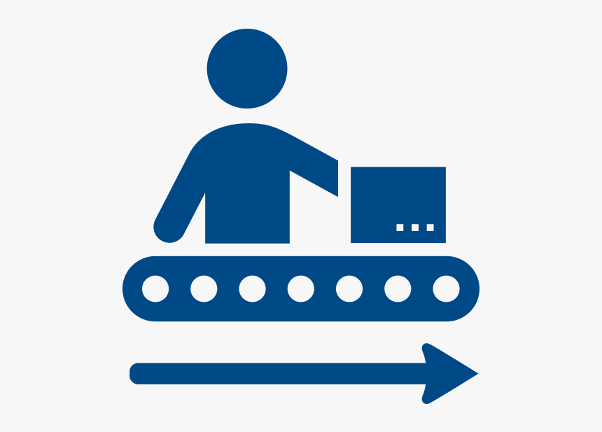
Production Line Concept

Slide 5

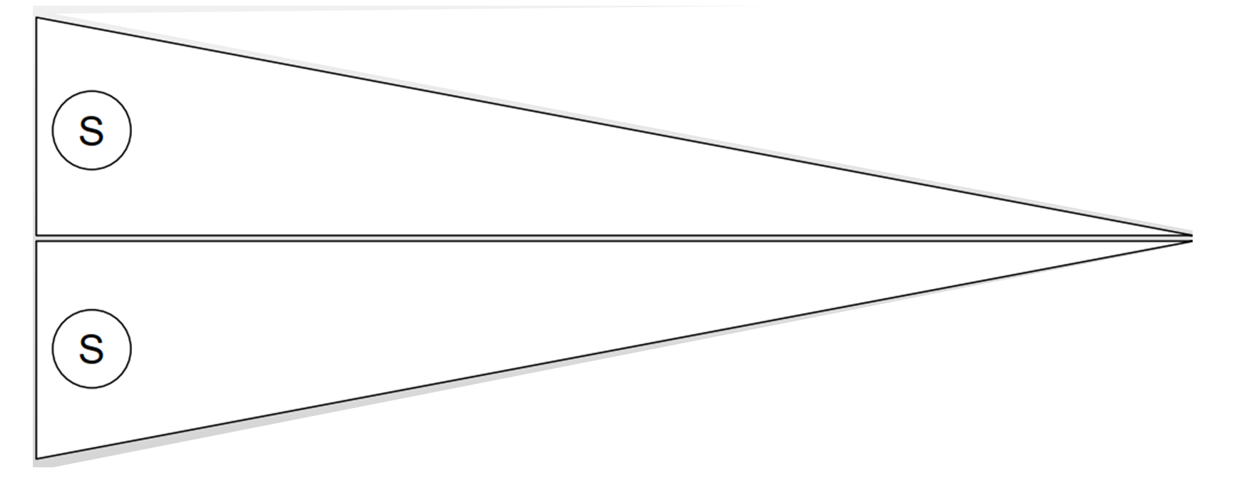
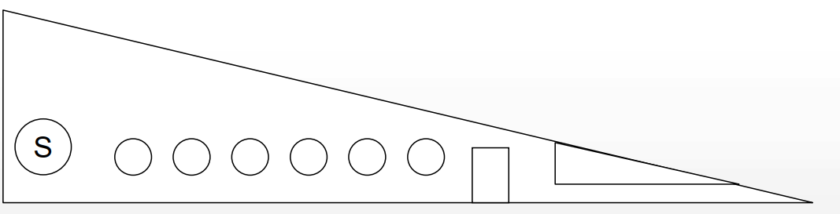
Step 0: Materials Prep
aircraft_frame1.png
aircraft_frame2.png

Slide 6

What does the Customer want?
The customer wants the maximum number of aircraft that can be produced within 3 minutes and that have the following characteristics:
the aircraft must be painted;
windows and doors must be painted black or blue;
the tail must have a logo.

Slide 7
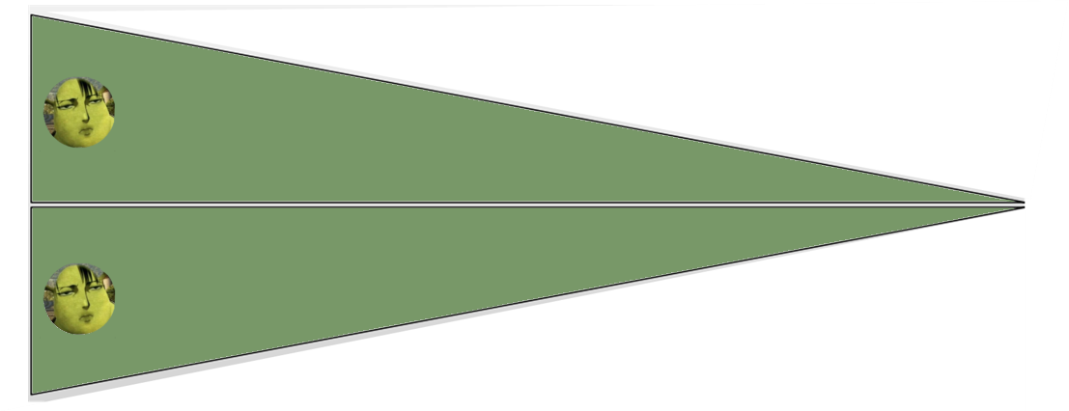
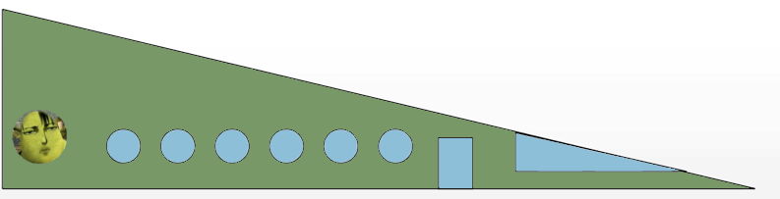
What does the Customer want?

Slide 8

Project Setup
Each team will create a whiteboard in Miro (https://miro.com).
The students sign into a Breakout room in Zoom.
Add each team member to the Miro (5 min).
Download the excel and the picture files.
Selection of SM and QM.

Slide 9
Roles
Each team member can only have one activity; however, roles can change with each sprint:
SCRUM Master (SM): responsible for conducting the process and measuring the team’s performance;
Quality Manager (QM): responsible for checking the quality of the product.
Product Owner (PO): responsible for accepting the product.

Slide 10
Scrum Directions
Planning
(1 min)
Sprint
(3 min)
Retrospective
(2 min)
You will have 3 sprints with 3 minutes each to produce the aircraft.
We will use the Whiteboard to produce the aircraft and use the Breakout room to realize the coordination and talking.
4 sprints

Slide 11
Directions
Planning
(1 min)
Sprint
(3 min)
Retrospective
(2 min)
During the planning, SM, QM, and the team need to agree on the estimation of the number of aircraft they can produce in 3 minutes.
After this meeting, SM joins the main room and informs the estimation to Professor.
4 sprints

Slide 12
Directions
Planning
(1 min)
Sprint
(3 min)
Retrospective
(2 min)
After the sprint time, the team needs to return to the main room to realize the demo of your aircraft.
In Sprint 3, the SM and the QM will change.
4 sprints

Slide 13
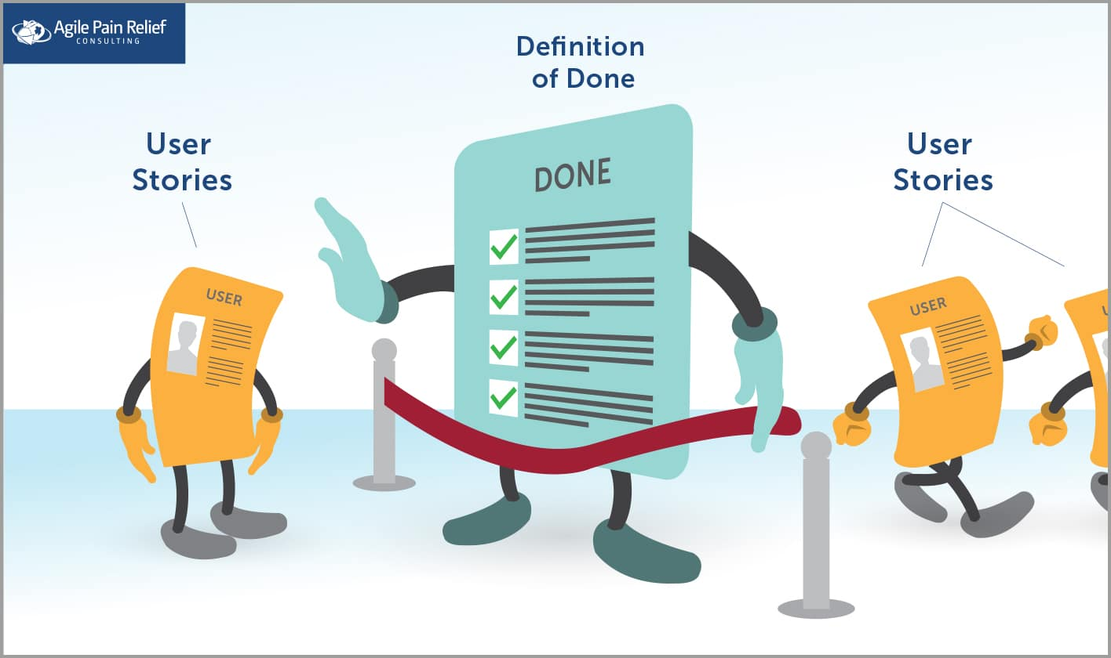
Acceptance Criteria
Each plane is properly color coded.
The required changes are incorporated.

Slide 14
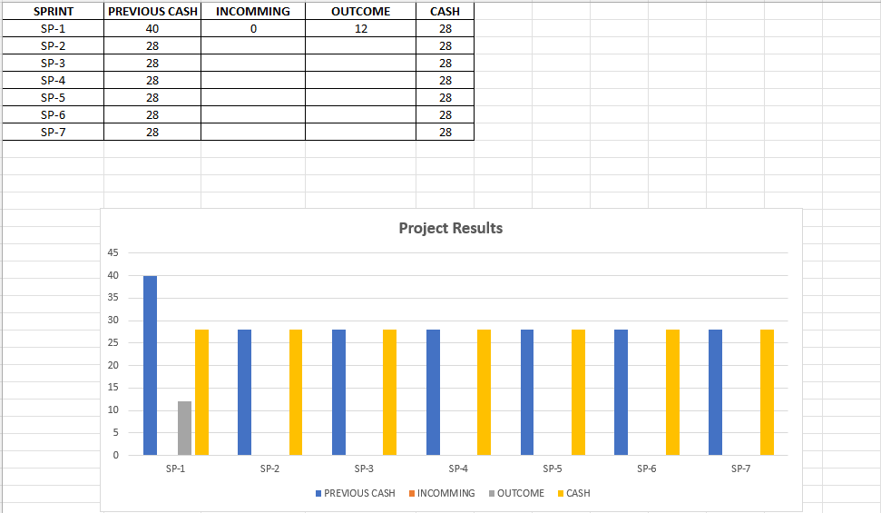
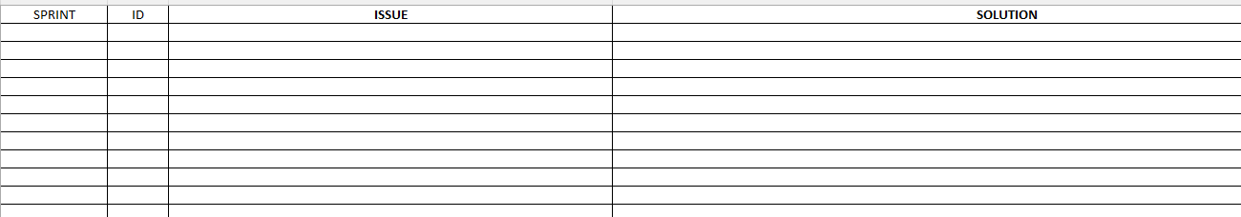
Scrum Master
PO is responsible for controlling the time and costs.

Slide 15

5 aircrafts

Slide 16

five aircrafts
Aircraft with two colors.

Slide 17

Discussion

Slide 18

Build the Spreadsheet (Results)
Production Estimates and Limits
Prototyping and creating customer value
Notes:
II - (they should note that the effort is equal in both cases);

Slide 19
Inspection and adaptation
Bottlenecks and Fixes
Teamwork
Empowerment
Notes:
II - (they should note that the effort is equal in both cases);

Slide 20
Use of sprints: It's better to deliver all planes in 10 minutes or a % every 3 minutes?
Notes:
II - (they should note that the effort is equal in both cases);

Slide 21


Unit 1 – Software Engineering Review

